Slide 1
Introducing Django
by Jacob Senecal

Slide 2
What is Django?
Install Django
Create a Django Project
Create a Voting App)
Set up the Django Admin
Create an index page
Create a voting page
We will be roughly following the Django online tutorial https://docs.djangoproject.com/en/1.8/intro/

Slide 3

So…What is Django?
A platform for building web applications
Runs on Python
Designed for quickly developing secure, scalable applications

Slide 4
Key Django Features
Object-relational mapper (ORM)
Admin interface
Template system
Internationalization

Slide 5



Django at Simon Solutions
Started using Django in 2009
Django is now our primary development platform
Used in CharityTracker, Oasis Insight and custom web apps

Slide 6
Installing Django
First you need Python
Works with Python 2.7 and 3.2
Also, we will be using virtualenv

Slide 7
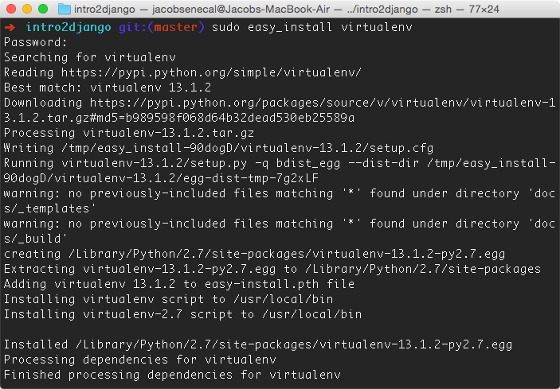
Install Virtualenv

Slide 8
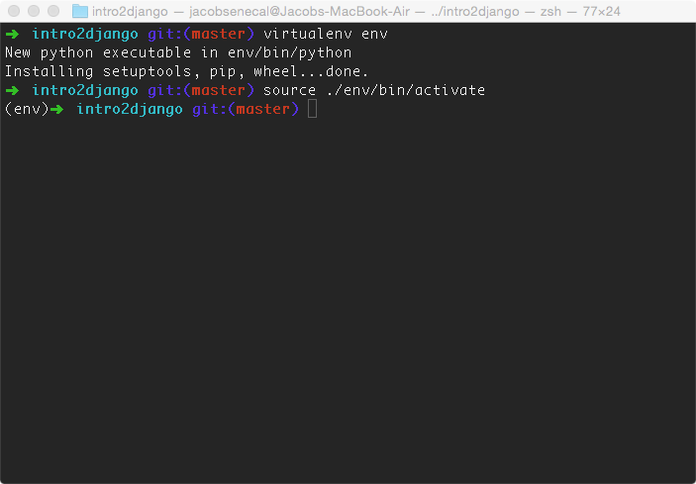
Set Up Virtualenv

Slide 9
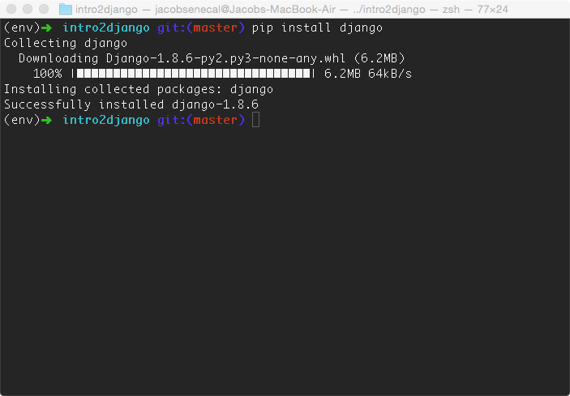
Install Django

Slide 10
Create a Django Project
Start a new Django project
Edit settings.py
Create database
Run server
Browser test

Slide 11
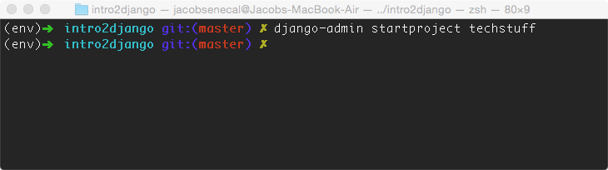
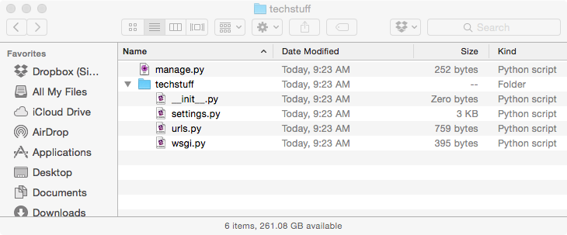
Start a Project

Slide 12
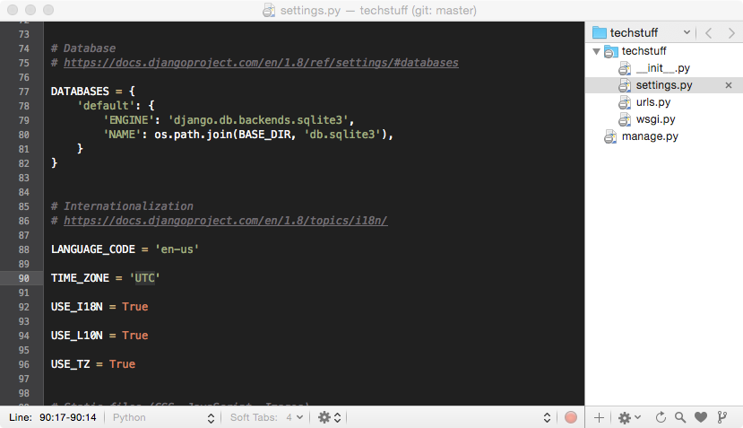
Edit settings.py

Slide 13
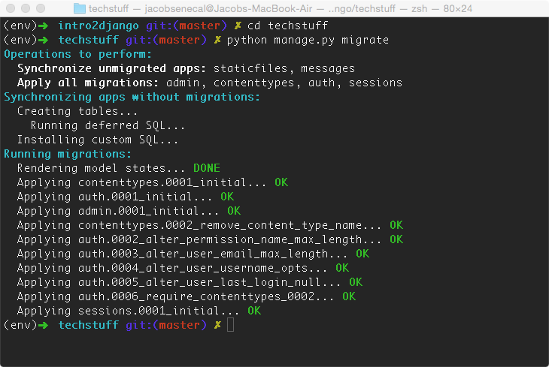
Create Database

Slide 14
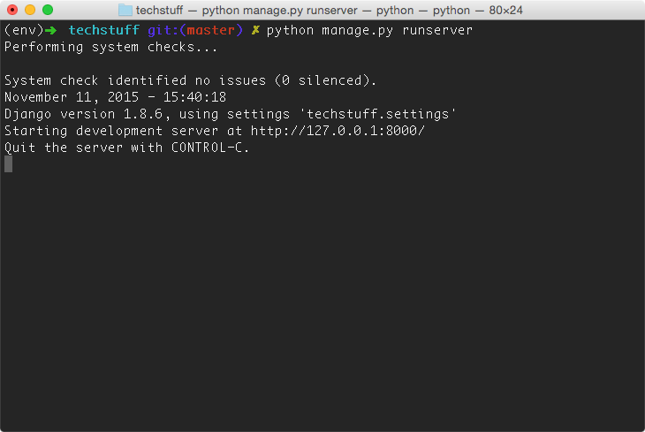
Run Server!!!

Slide 15
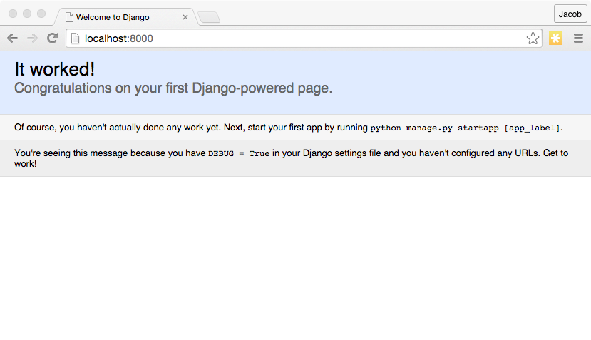
Browser Test

Slide 16
Create a Voting App
Start a new Django app
Create models
Update settings
Create migrations
Django does SQL!
Apply migrations

Slide 17
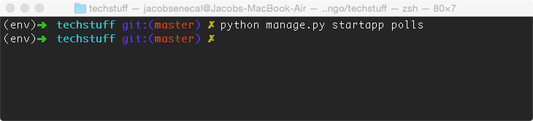
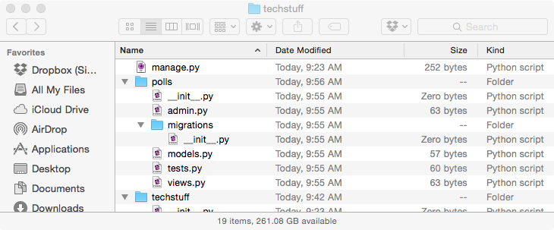
Start an App

Slide 18
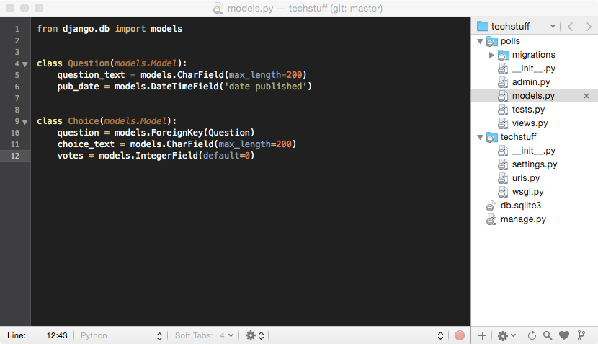
Create Models

Slide 19
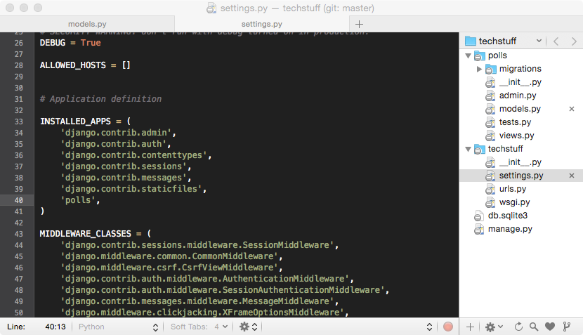
Update Settings

Slide 20
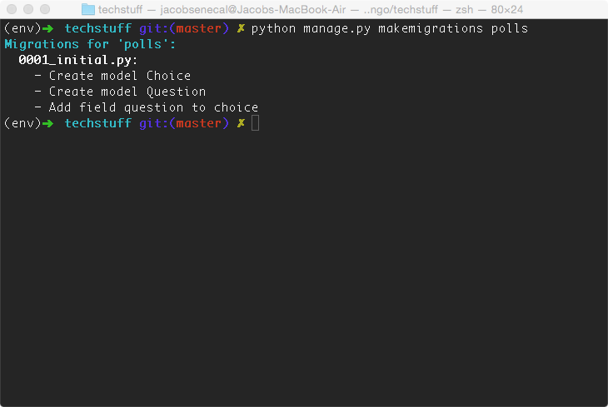
Create Migrations

Slide 21
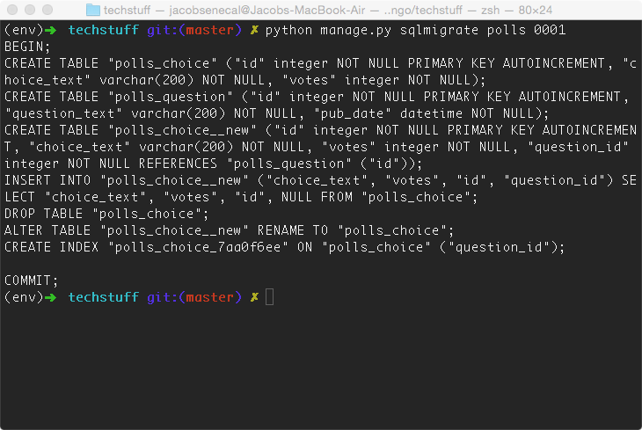
Django Does SQL

Slide 22
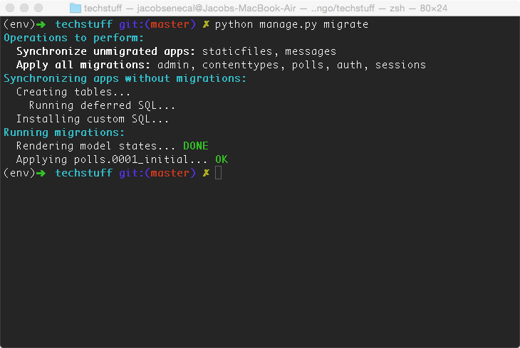
Apply Migrations

Slide 23
Setting Up Django Admin
Create a superuser
Log in to the admin site
Customize the admin
Add something to the database

Slide 24
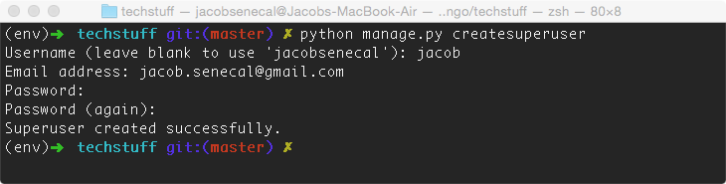
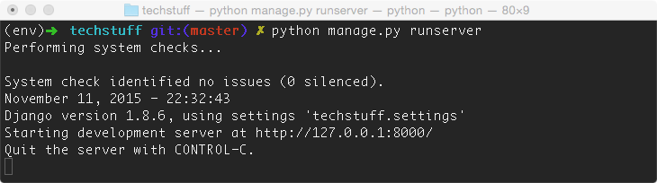
Create a Superuser

Slide 25
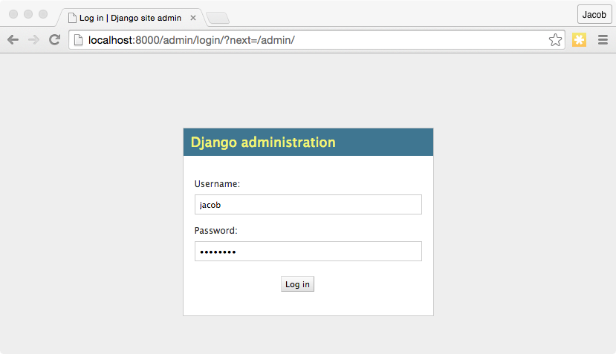
Login to Admin Site

Slide 26
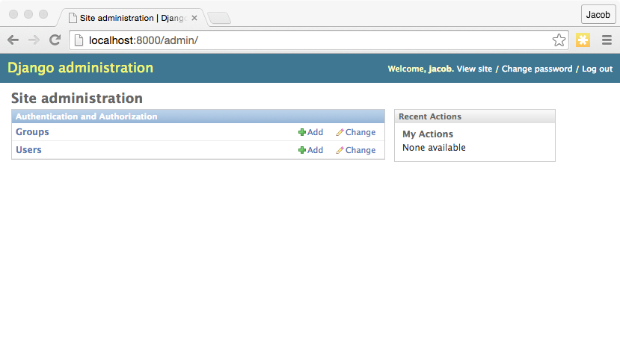
Django Admin

Slide 27
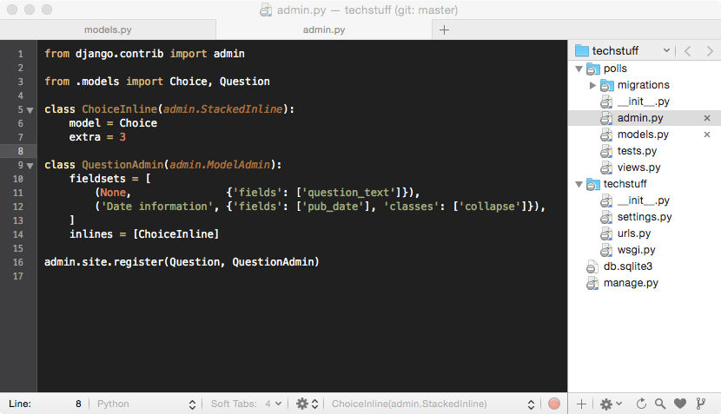
Customize the Admin

Slide 28
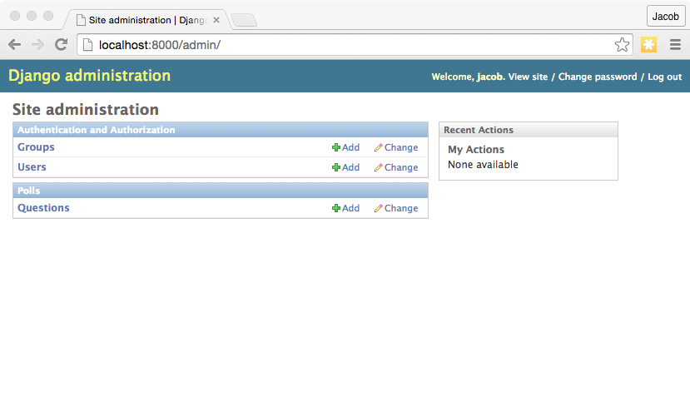
View Customizations

Slide 29
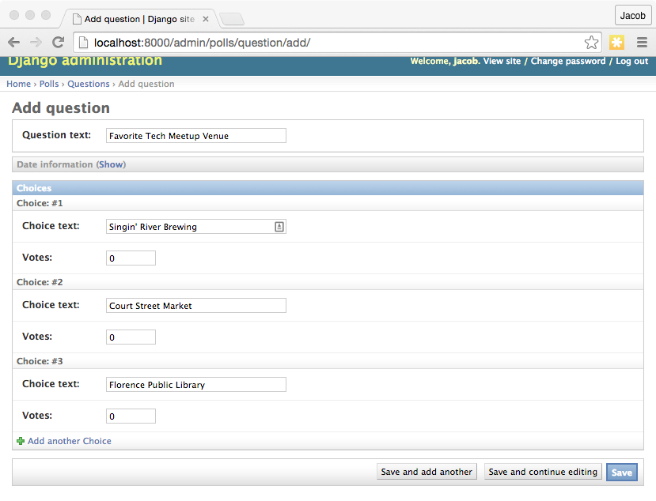
Add a Question!

Slide 30
Create an Index Page
Add a view function
Create a template
Add a url pattern for the view
Browser test

Slide 31
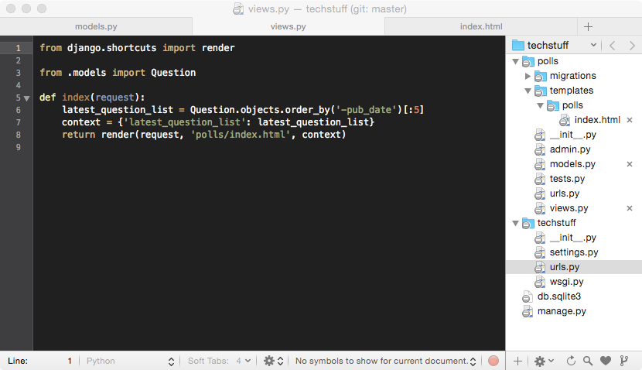
Add View Function

Slide 32
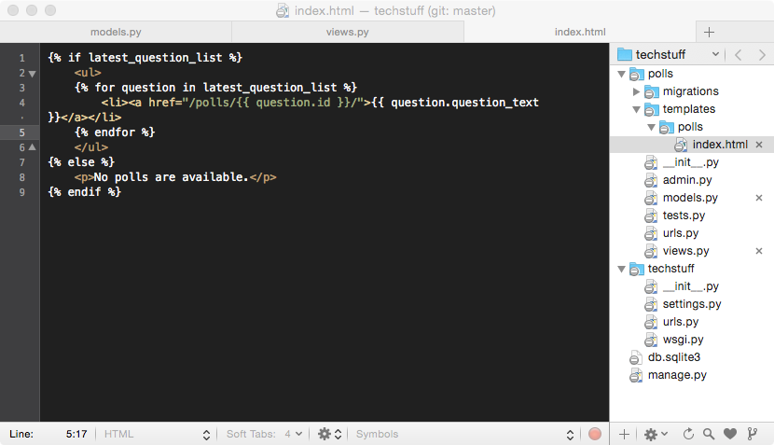
Create a Template

Slide 33
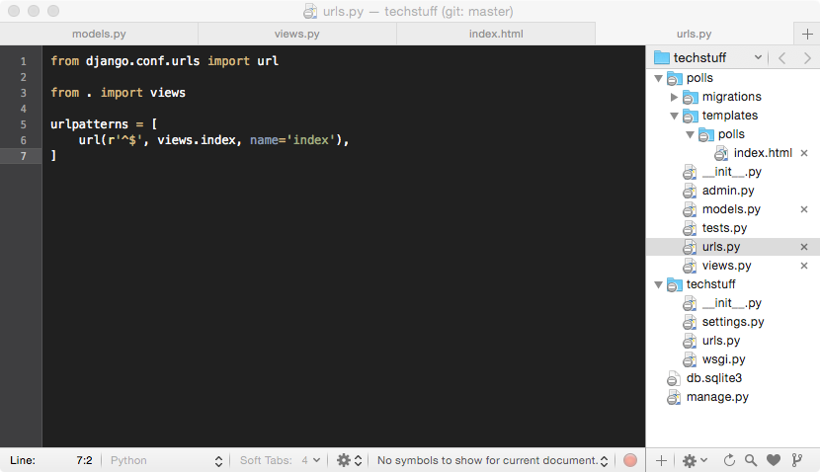
Add a URL Pattern

Slide 34
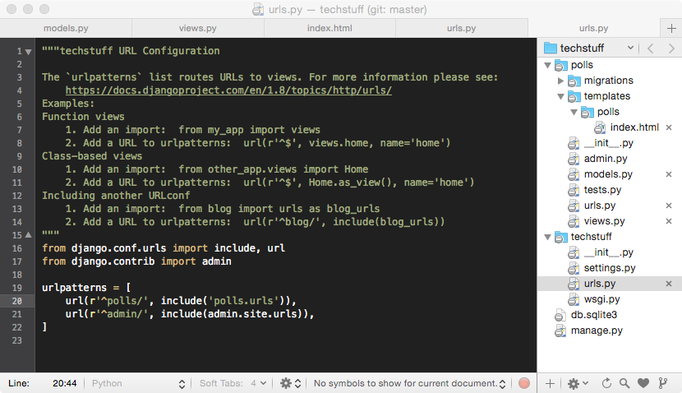
Add to Project URLs

Slide 35
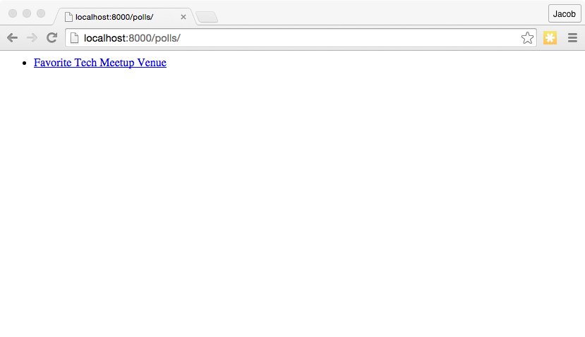
It Works!

Slide 36
Create a Voting Page
Add a view function
Create a template
Add a URL pattern for the view
Start voting!

Slide 37
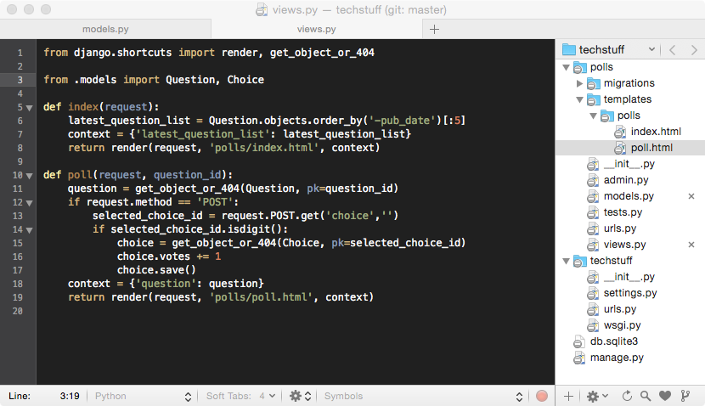
Add Voting View

Slide 38
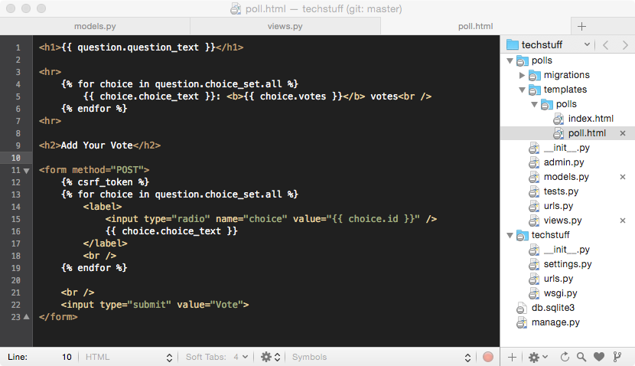
Create Poll Template

Slide 39
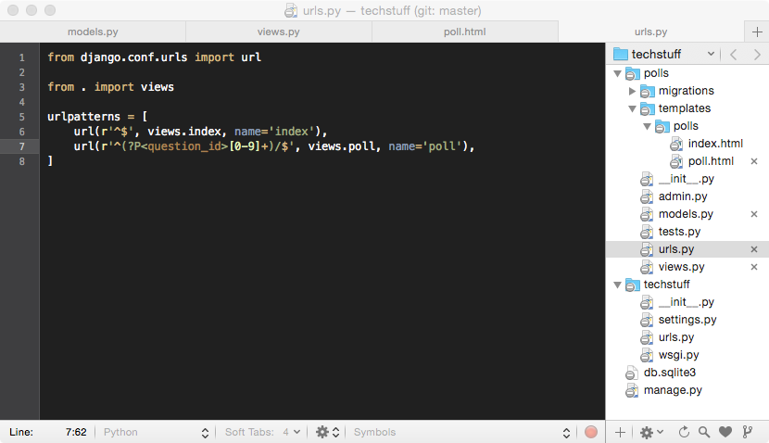
Add URL Pattern

Slide 40
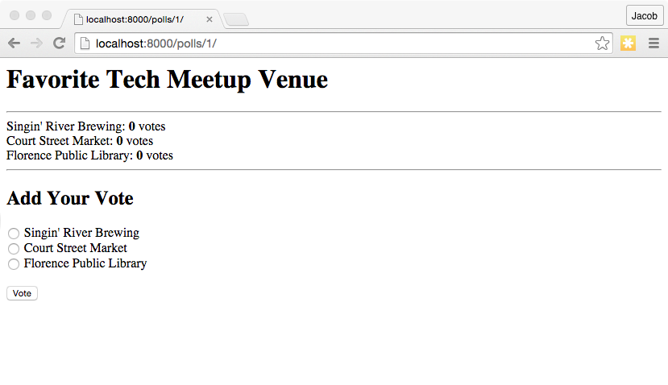
Start Voting!

Slide 41
Django is Awesome!
Everybody can vote:
Voting app and slides are at github.com/jakesen/intro2django
More info at djangoproject.com
Join the Django channel on tech256

